Slide 1
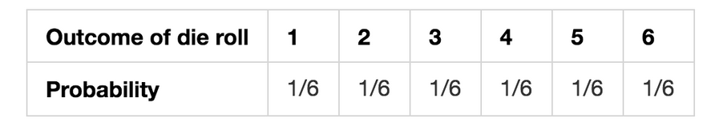
Probability Distribution
A probability distribution is a list of all of the possible outcomes of a random variable along with their corresponding probability values.
Example:
probability distribution of a fair 6-sided die.

Slide 2
Types of Distributions:
Discrete Probability Distribution
Bernoulli Distribution (random variable has only two outcomes)
Binomial Distribution (random variable is sequence of trial of have two outcomes)
Continuous Probability Distribution
Uniform Distribution (equal probability for all outcomes)
Normal Distribution
Poisson Distribution (number of events in a time interval)
Exponential Distribution (time between two events)

Slide 3

Bernoulli Distribution
A random experiment that has only two outcomes (usually called a “Success” or a “Failure”)
Probability of success is denoted by p and probability of failure as (1-p)
The probability density function is given as below:

Slide 4

Binomial Distribution
A binomial experiment has four properties:
It consists of a sequence of n identical trials
Two outcomes, success or failure, are possible on each trial
The probability of success on any trial, denoted p, does not change from trial to trial
The trials are independent
The probability function is given as below:
Bernoulli is a special case of binomial with n = 1
Notes:
http://www.r-tutor.com/elementary-statistics/probability-distributions/binomial-distribution

Slide 5
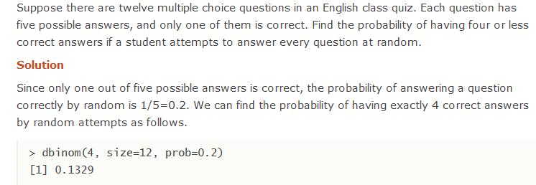

Slide 6
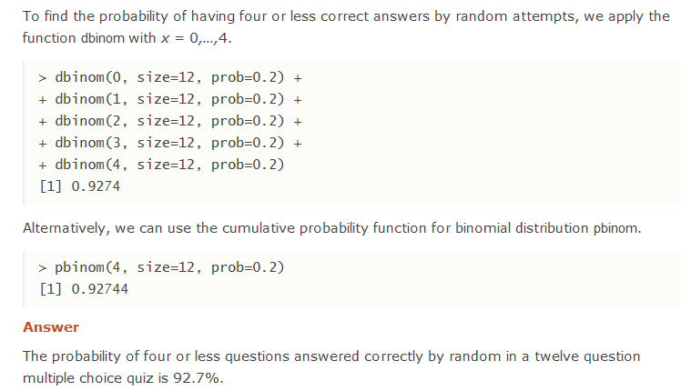

Slide 7
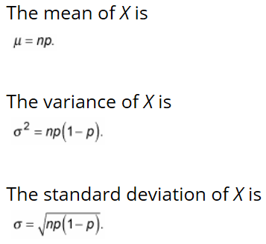
Binomial Distribution

Slide 8


Poisson Distribution
The Poisson probability distribution is often used as a model of the number of arrivals at a facility within a given period of time.
https://towardsdatascience.com/the-poisson-distribution-and-poisson-process-explained-4e2cb17d459
Examples –
No of customers arriving at a subway stores during lunch hour
No of errors per line of software code
It assumes no limit on no of occurrences ( X can assume any non negative integer value)
Occurrences are independent and avg no of occurrences per unit is constant.
Notes:
http://www.statisticslectures.com/topics/meanstandarddeviationpoisson/
https://en.wikipedia.org/wiki/Poisson_distribution

Slide 9
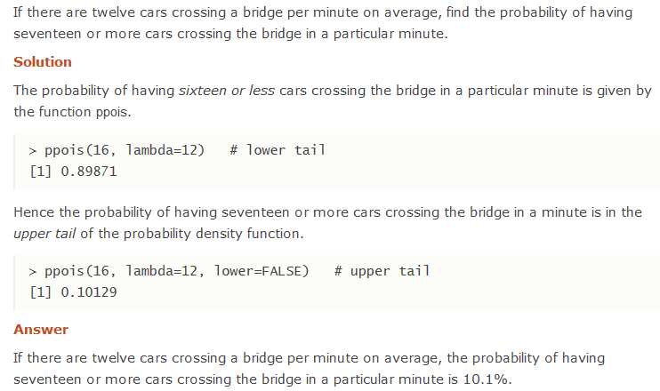

Slide 10
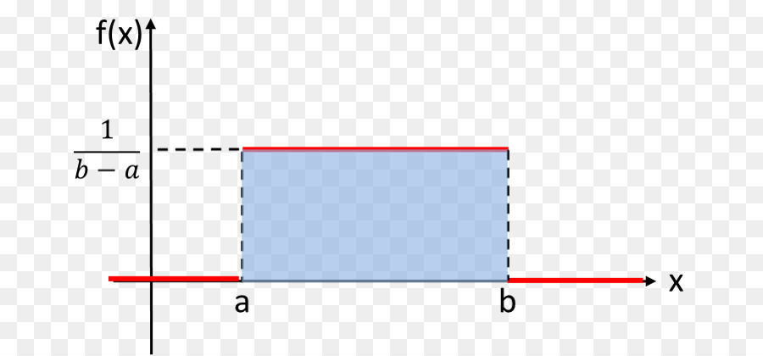

Uniform Distribution
A uniform distribution, also called a rectangular distribution, is a probability distribution that has constant probability.
This distribution is defined by two parameters, a and b:
a is the minimum.
b is the maximum.

Slide 11
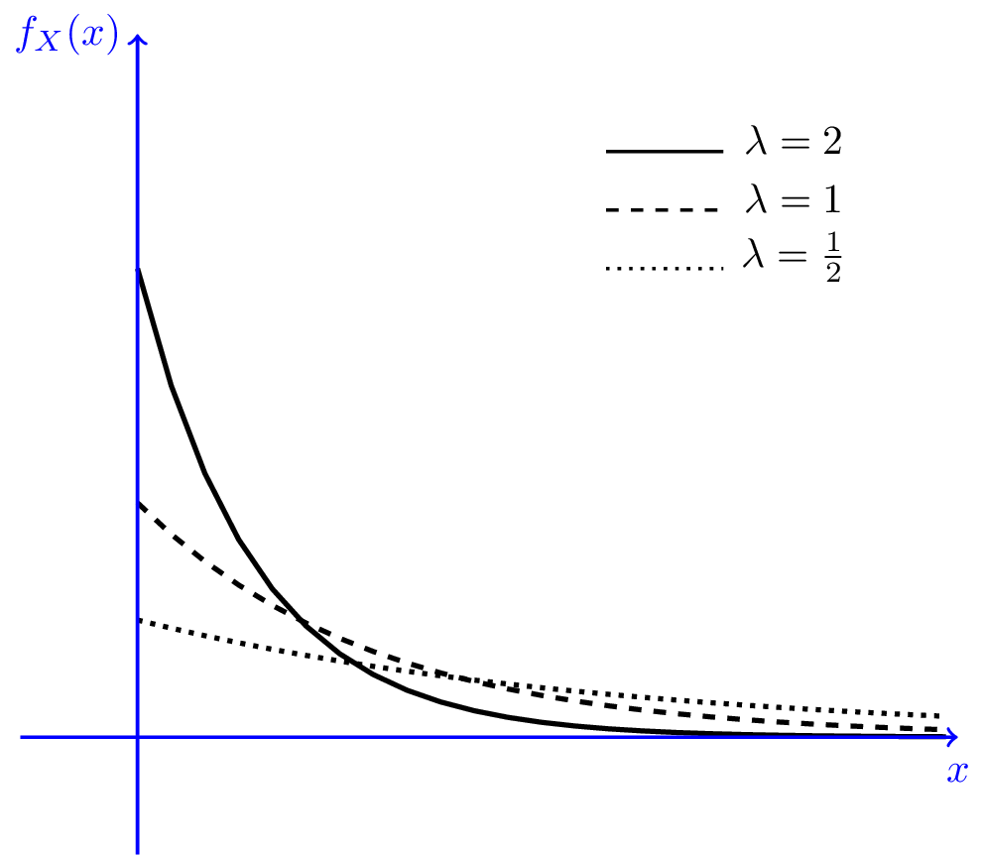



Exponential Distribution
It is often used to model the time elapsed between events.
Often used in such applications as modelling time between customer arrivals to a service system or the time to or between failures of machines.
If the number of events occurring during as interval of time has a Poisson distribution, then the time between events is exponentially distributed.

Slide 12
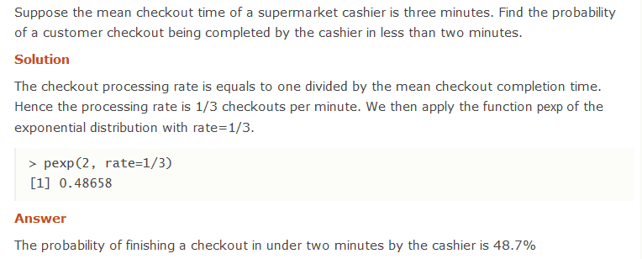

Slide 13
Plotting in R
install.packages("esquisse", repos ='http://cran.us.r-project.org')
library(esquisse)
esquisse::esquisser()
https://cran.r-project.org/web/packages/esquisse/readme/README.html

Slide 14
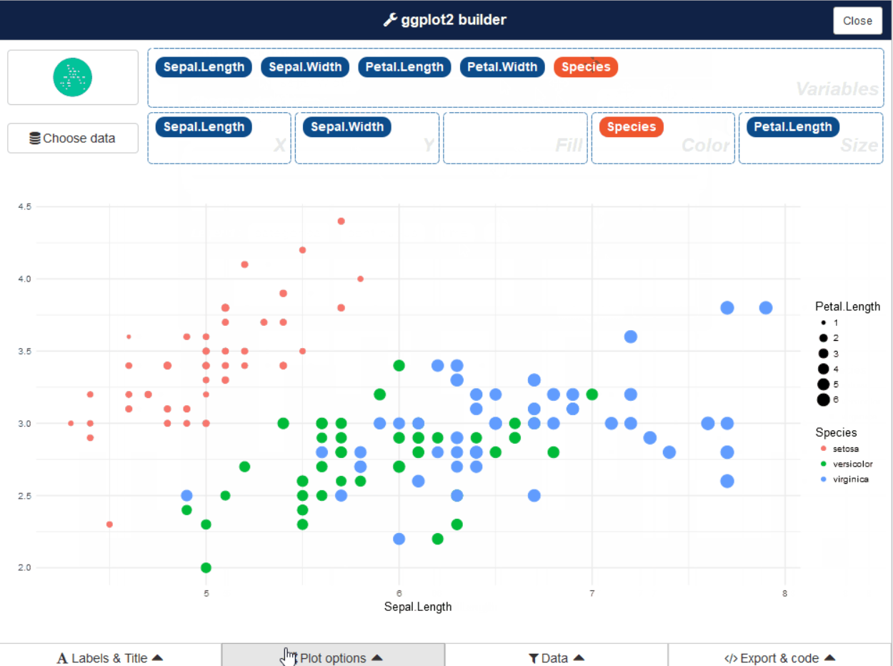

Slide 15
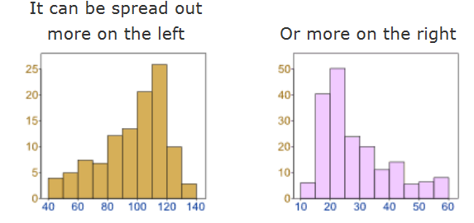
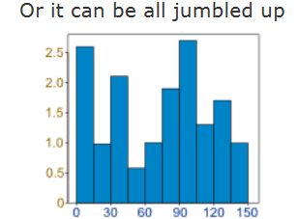
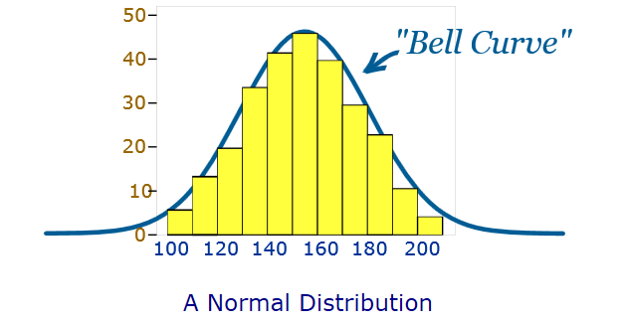
Distribution of vehicle speed (airport road, koramangla, Marathalli)
Data tends to be around a central value with no bias left or right, and it gets close to a "Normal Distribution"
heights of people
size of things produced by machines
errors in measurements
blood pressure
marks on a test
Notes:
https://www.mathsisfun.com/data/standard-normal-distribution.html

Slide 16
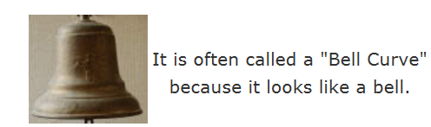
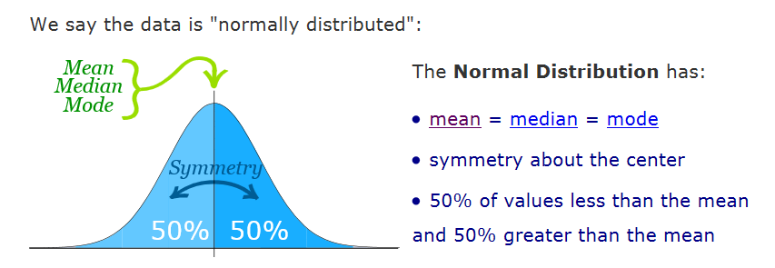
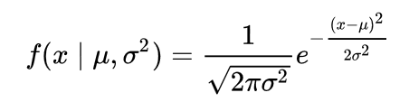
skewness is zero

Slide 17
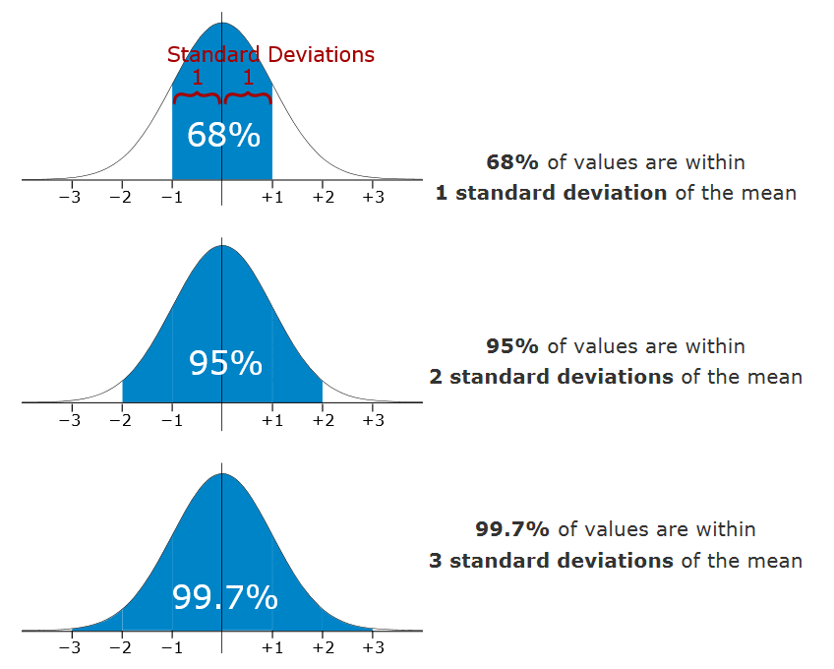
Empirical Rule
The empirical rule tells you what percentage of your data falls within a certain number of standard deviations from the mean:
likely to be within 1 standard deviation (68 out of 100 should be)
very likely to be within 2 standard deviations (95 out of 100 should be)
almost certainly within 3 standard deviations (997 out of 1000 should be)

Slide 18
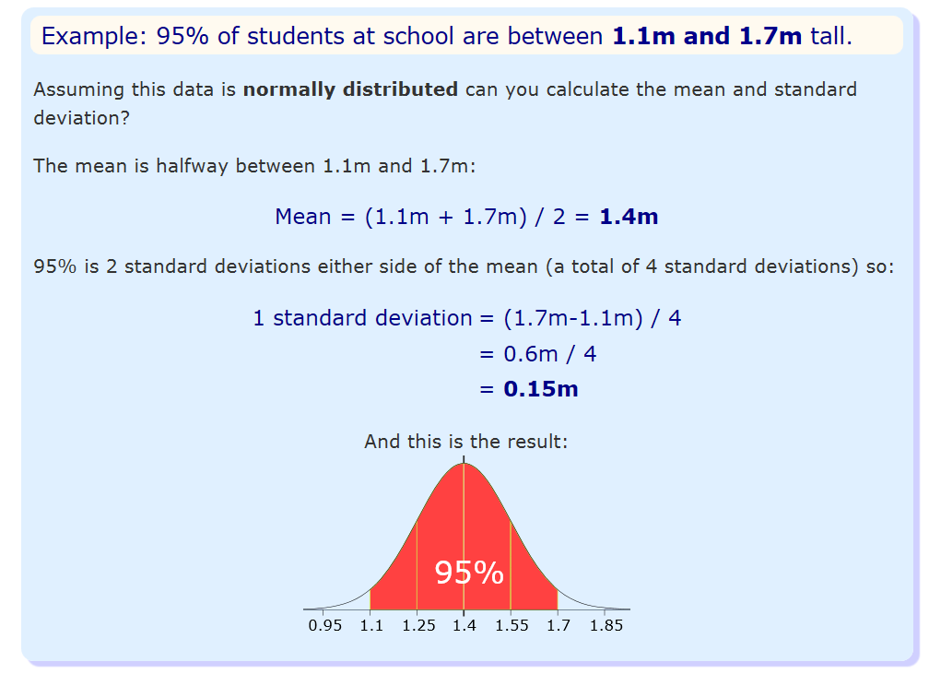

Slide 19
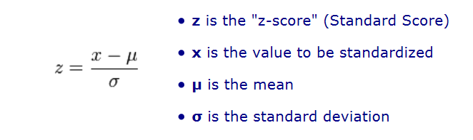
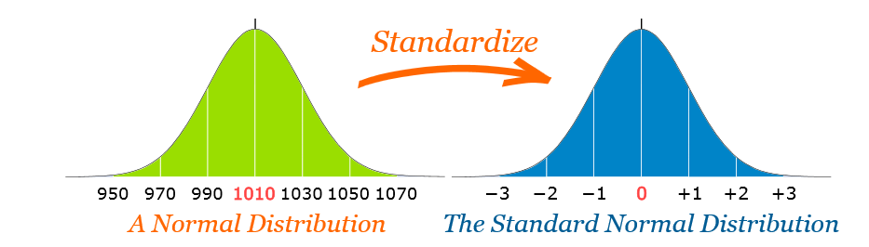
Standard Normal Distribution
Standard normal distribution is a special case of normal distribution where mean = 0 and S.D = 1
Convert a value to a Standard Score ("z-score"):
first subtract the mean, then divide by the Standard Deviation

Slide 20
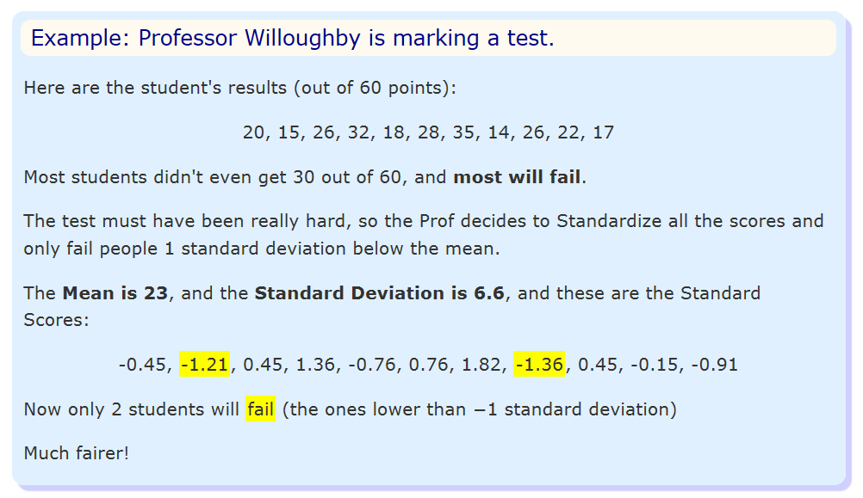

Slide 21
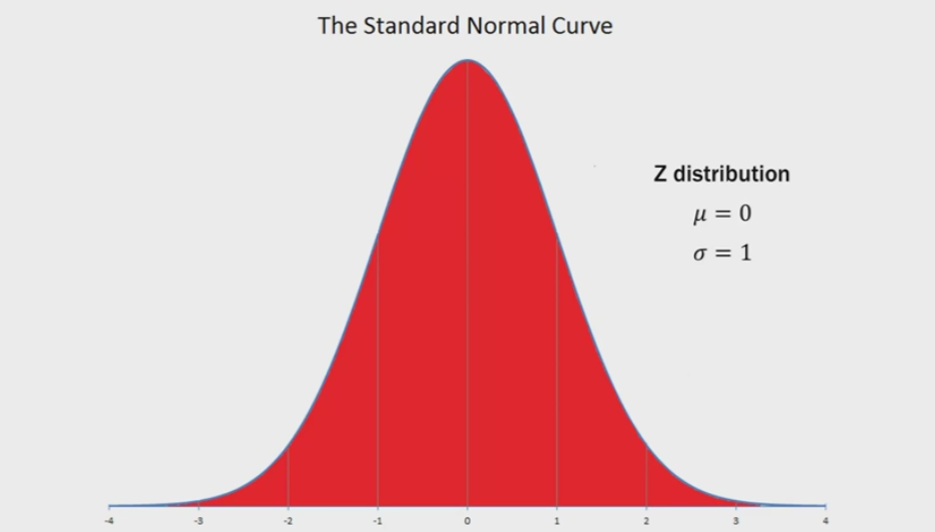
Total probability under the curve is 1 (sum of probability of all outcomes)

Slide 22
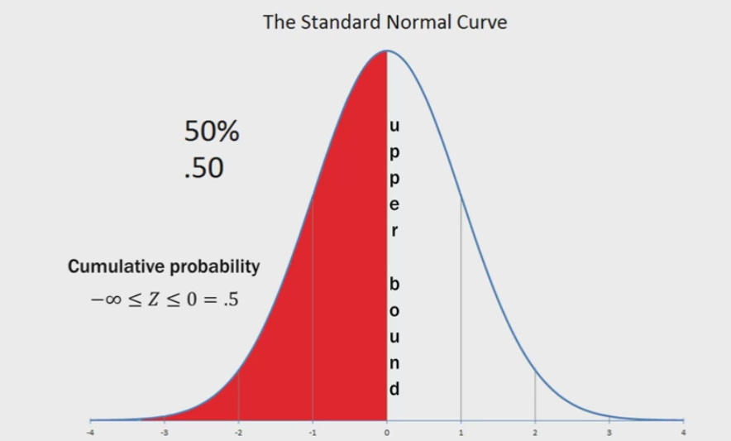

Slide 23
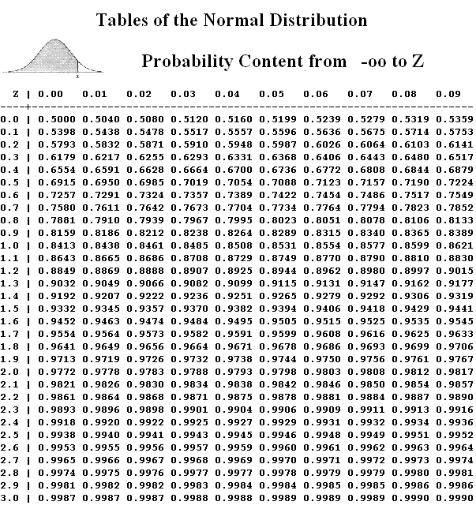
A standard normal distribution table shows a cumulative probability associated with a particular z-score.
Table rows show the whole number and tenths place of the z-score.
Table columns show the hundredths place.
The cumulative probability (often from minus infinity to the z-score) appears in the cell of the table.

Slide 25
P(Z<=0) = 0.5
P(Z<=1.93)= 0.9732
P(Z<=-1.65)= 1- P(1.65) = 1- 0.9505 =0.05

Slide 26
P(-1.65 <Z<=1.93)
P(1.93)= 0.9732
P(-1.65)= 1- P(1.65) = 1- 0.9505 =0.05
P(1.93)- P(-1.65)= 0.9732- 0.05 = 0.93

Slide 27
Use the Standard Normal Distribution table to find
P(0 < Z ≤ 1) = 0.3413
P(-1.65 < Z ≤ 1.93) =0.92
P(0.85 < Z ≤ 2.23) =0.1848
P(Z > 1.75) =0.0401 = 1-P(Z<=1.75)
P(Z ≤ -0.69)= 0.2451
P(-1.27 < Z ≤ 0)=0.398 = P(Z<=0)- Z(Z<= -1.27)
P(Z > -2.64) =0.9959
P(Z ≤ 0.96)=0.8315

Slide 28
pnorm(x,mean,sd, lower.tail)
lower.tail : logical; if TRUE (default), probabilities are P[X ≤ x] otherwise, P[X > x].
This function gives the probability of a normally distributed random number to be less that the value of a given number. It is also called "Cumulative Distribution Function".
qnorm() : opposite of pnorm
This function takes the probability value and gives a number whose cumulative value matches the probability value.

Slide 29
#P(0 < Z ≤ 1)
#P(z<=1)-P(z<=0)
pnorm(1, mean=0,sd=1)- pnorm(0, mean=0,sd=1)
#P(-1.65 < Z ≤ 1.93)
pnorm(1.93, mean=0,sd=1)- pnorm(-1.65, mean=0,sd=1)
#P(0.85 < Z ≤ 2.23)
pnorm(2.23, mean=0,sd=1)- pnorm(0.85, mean=0,sd=1)

Slide 30
#P(Z > 1.75)
pnorm(1.75, mean=0, sd=1, lower.tail = FALSE)
#to get Z value according to probability
qnorm(0.5)
qnorm(1)
qnorm(0.75)

Slide 31
P(0.85 < Z ≤ 2.23)
P(Z<=2.23) = 0.9871
P(z<=0.85)= 0.802
P(z<=2.23)- P(z<= 0.85)=

Slide 32
P(Z > 1.75) = 1- P(Z<=1.75)

Slide 33
Why Standardize?
It can help us make decisions about our data.
It also makes life easier because we only need one table (the Standard Normal Distribution Table), rather than doing calculations individually for each value of mean and standard deviation.

Slide 34
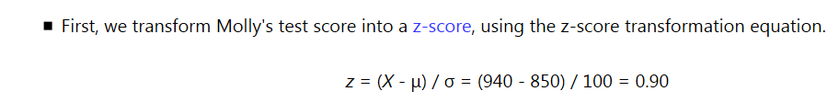
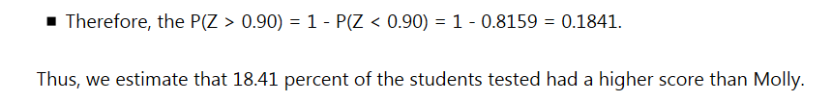
Molly earned a score of 940 on a national achievement test. The mean test score was 850 with a standard deviation of 100. What proportion of students had a higher score than Molly? (Assume that test scores are normally distributed.)
Notes:
https://stattrek.com/probability-distributions/standard-normal.aspx

Slide 35
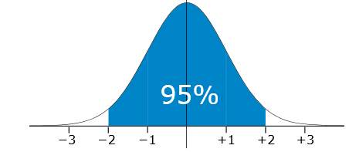
The Taj Tea Company pack tea in bags marked as 250 g A large number of packs of tea were weighed and the mean and standard deviation were calculated as 255 g and 2.5 g respectively. Assuming this data is normally distributed, what percentage of packs are underweight or weigh less than 250g?
P(X<250g)
Z= (250-255)/2.5 = -2
P(-2)= 2.5%

Slide 36
The mean June midday temperature in Kanpur is 36°C and the standard deviation is 3°C. Assuming this data is normally distributed, how many days in June would you expect the midday temperature to be between 39°C and 42°C?
Z1= (39-36)/3 =1
Z2= (42-36)/3= 2
P(Z=2)-P(Z=1)= 0.9772- 0.8413 = 0.1359 , almost 13% of days have temp b/w 39 and 42
No of days= 30*0.1359 =4.08 ~4 days

Slide 37
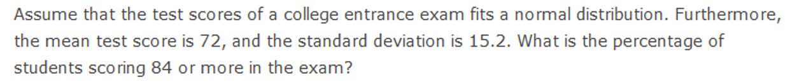

Slide 38
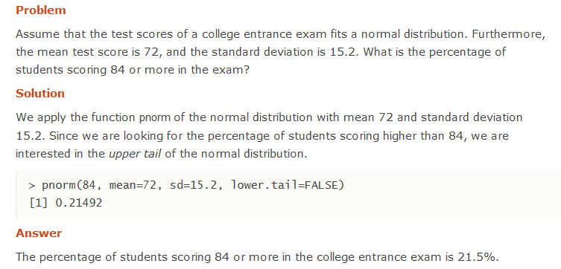

Slide 39
A machine produces electrical components. 99.7% of the components have lengths between 1.176 cm and 1.224 cm. Assuming this data is normally distributed, what are the mean and standard deviation?
mean- 3SD= 1.176
Mean+3SD=1.224
Mean= (1.176+1.224)/2= 1.2 , SD= (1.224-1.176)/6= 0.008

Slide 40
Mean Test Score= 72
Standard Deviation= 15.2
P(X>84) = 1- P(X<=84)
1- P(z<= (84-72)/15.2)
1- Pnorm(84,man=72, sd=15.2)

Slide 41
A company makes parts for a machine. The lengths of the parts must be within certain limits or they will be rejected. A large number of parts were measured and the mean and standard deviation were calculated as 3.1 m and 0.005 m respectively. Assuming this data is normally distributed and 99.7% of the parts were accepted, what are the limits?
3.1-3*0.005 =2.995
3.1+3*0.005=3.115

Slide 42
The heights of male adults are Normally distributed with mean 1.7 m and standard deviation 0.2 m In a population of 400 male adults, how many would you expect to have a height between 1.4 m and 1.6 m?
Z1= (1.4-1.7)/0.2= -1.5
Z2= (1.6-1.7)/0.2= -0.5
P(Z2)-P(Z1) = (1-0.6915) - (1-0.9332) =0.2417
400*0.2417= 96.68 ~97 students

Slide 43
The mean July daily rainfall in Bangalore is 10 mm and the standard deviation is 1.5 mm Assume that this data is normally distributed. How many days in July would you expect the daily rainfall to be less than 8.5 mm?

Slide 44
The ages of the population of a town are Normally distributed with mean 43 and standard deviation 14 The town has a population of 5,000. How many would you expect to be aged between 22 and 57?

